Slide 1
Department of Electrical and Computer Engineering
CSE 299
Faculty: Intisar Tahmid Naheen (ITN) Section: 12 Group:08 Submitted by Farzia Chowdhury (1522115642) Md. Seragis Salekin (1632228042) Md.Fuadul Islam (1631135542)

Slide 2
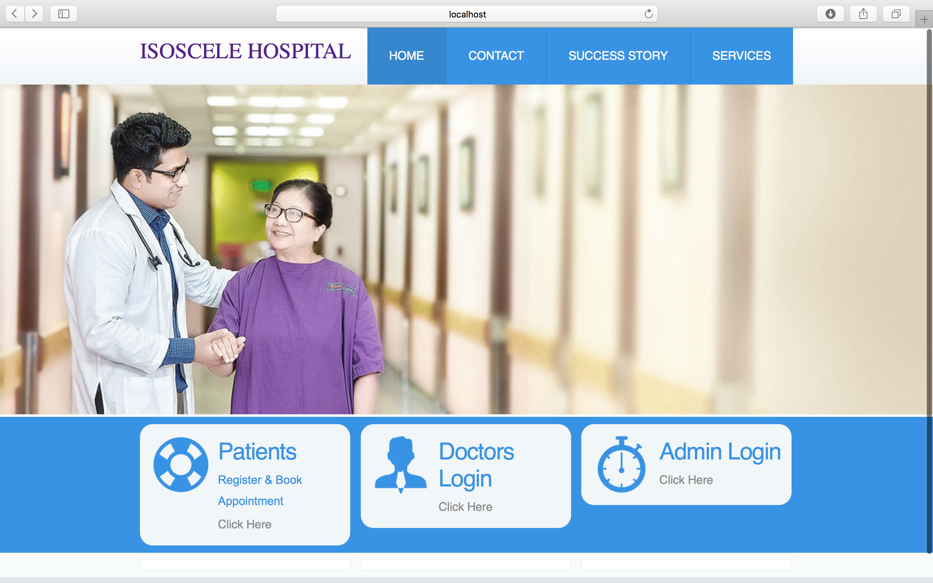

Slide 3
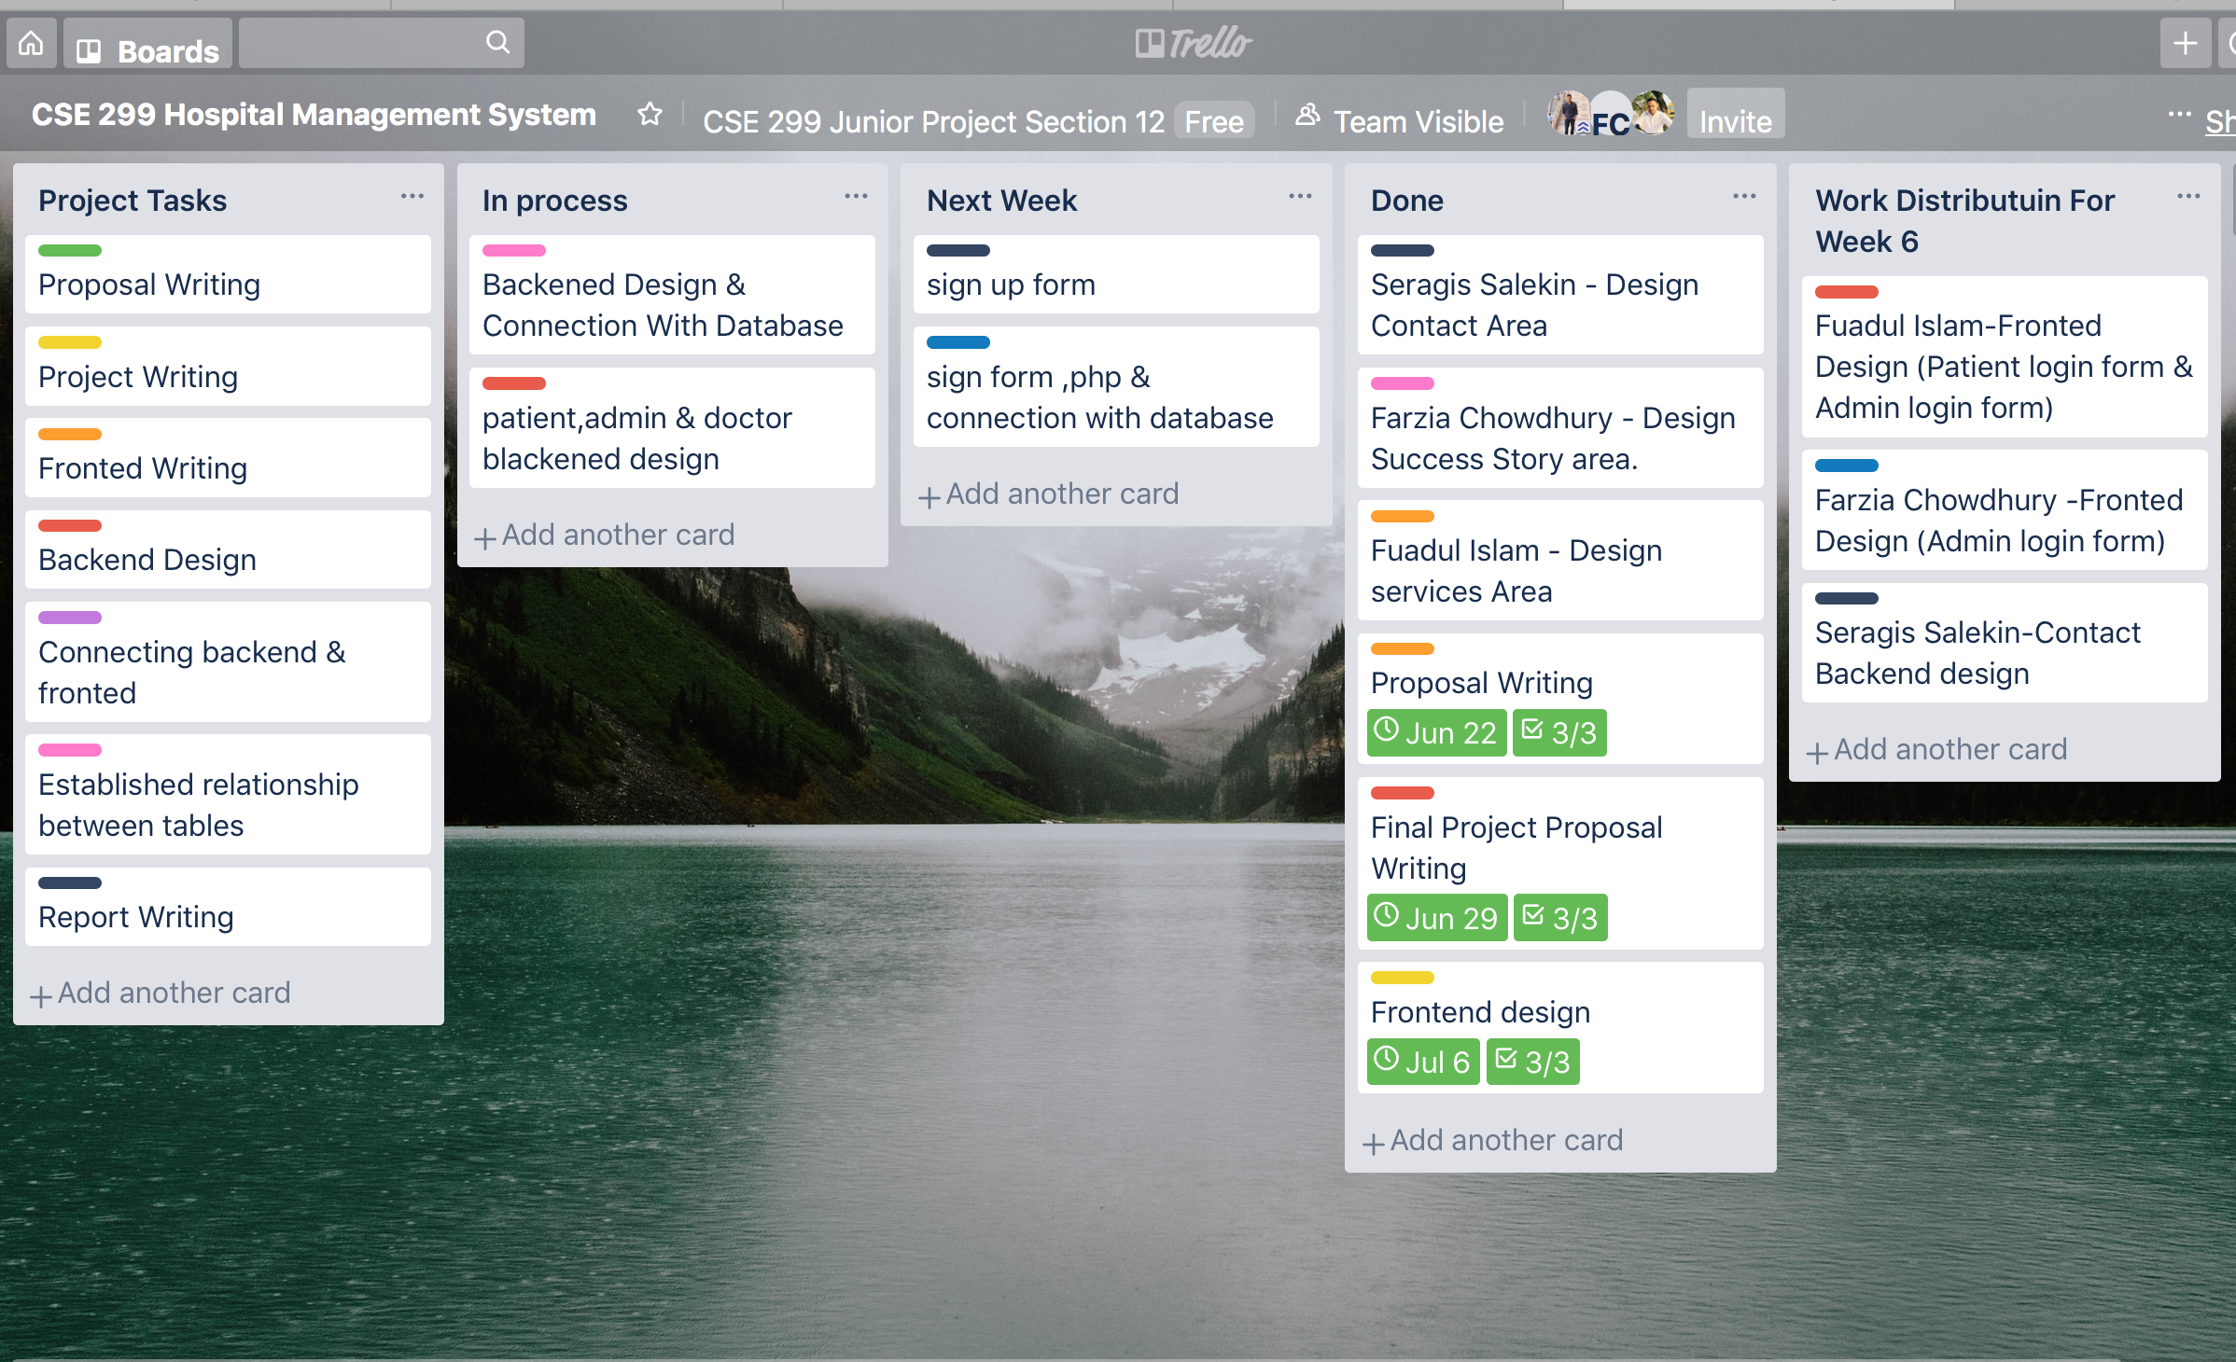

Slide 4
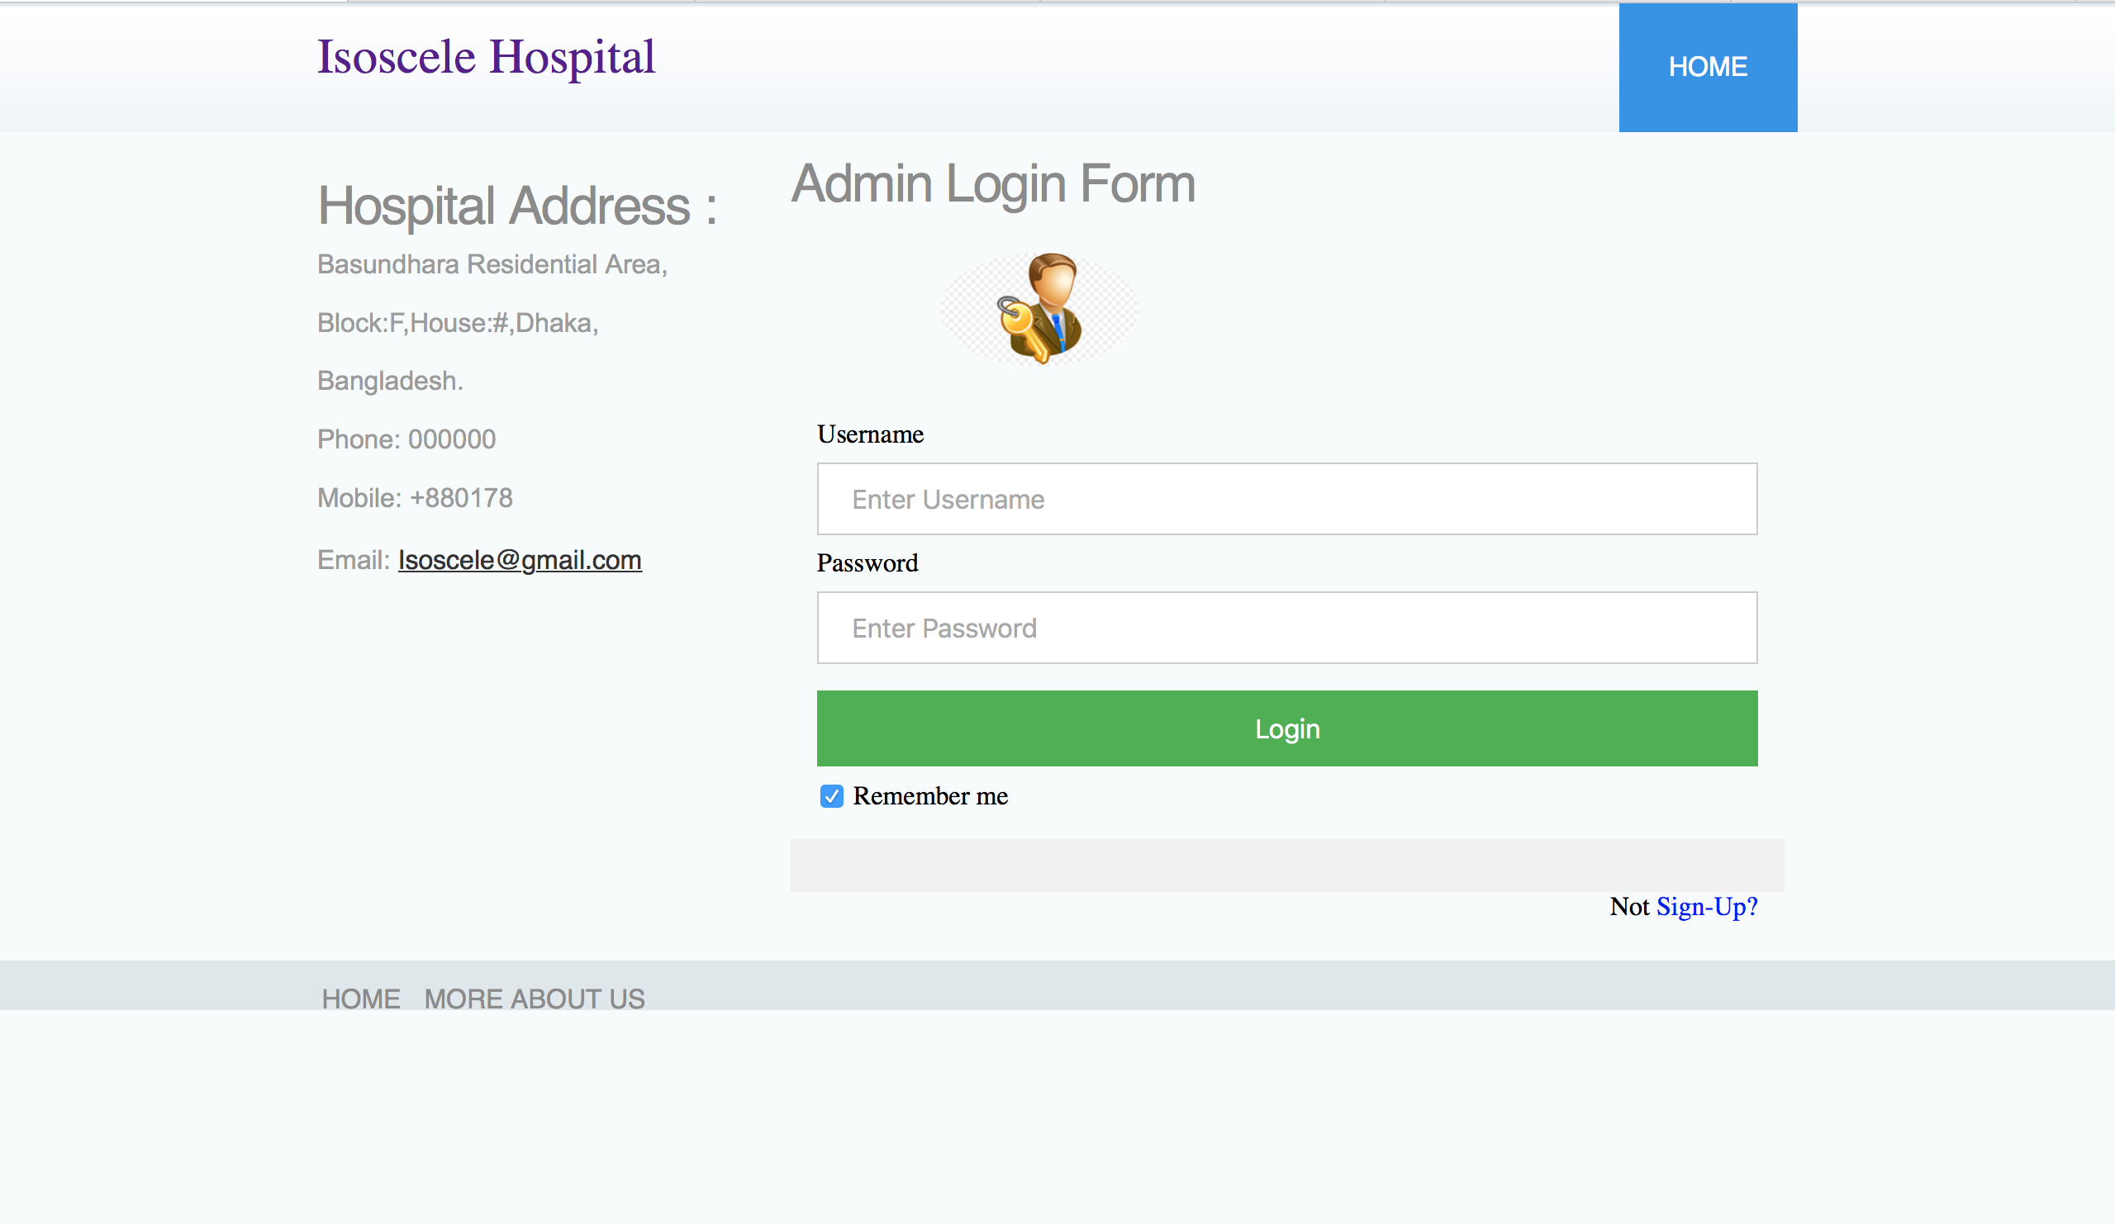

Slide 5
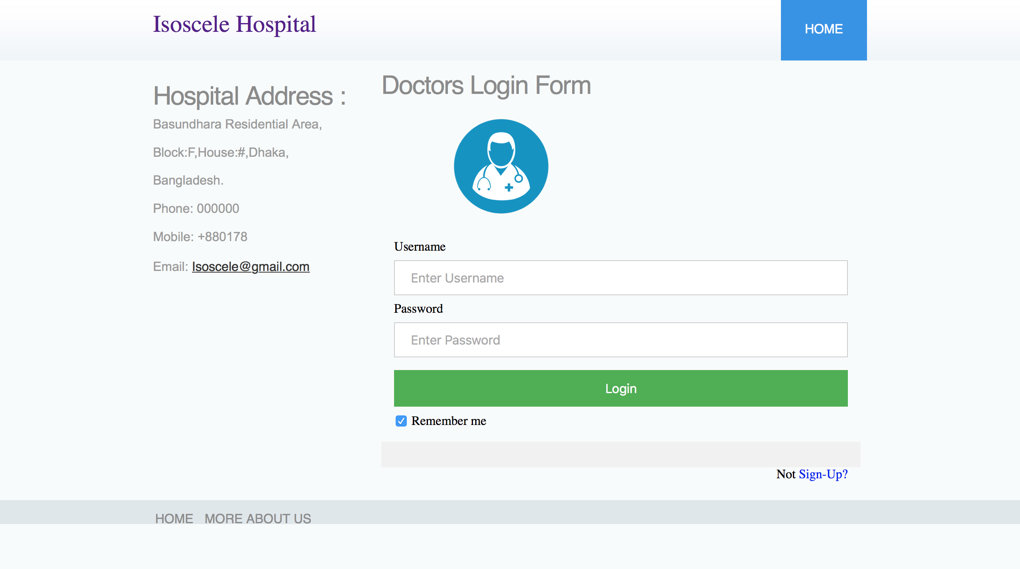

Slide 6
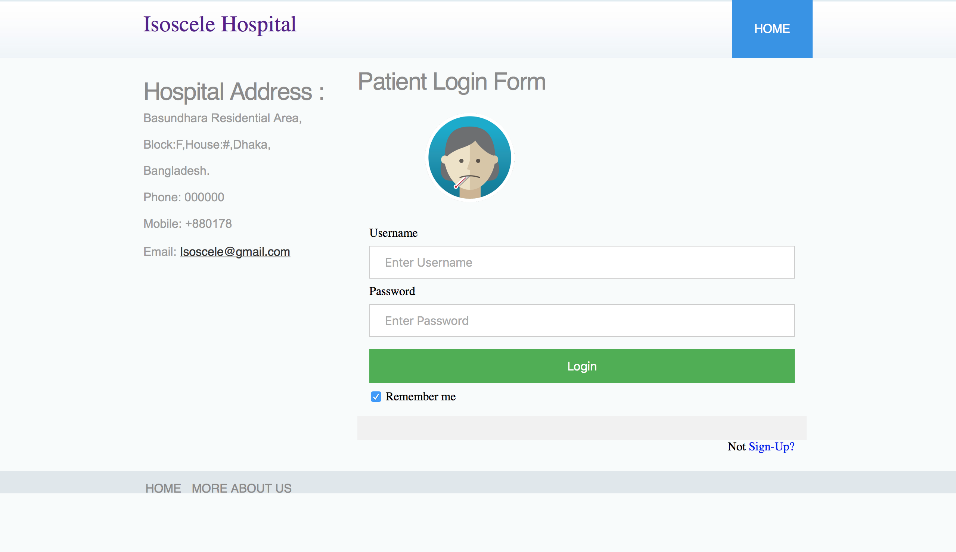

Slide 7
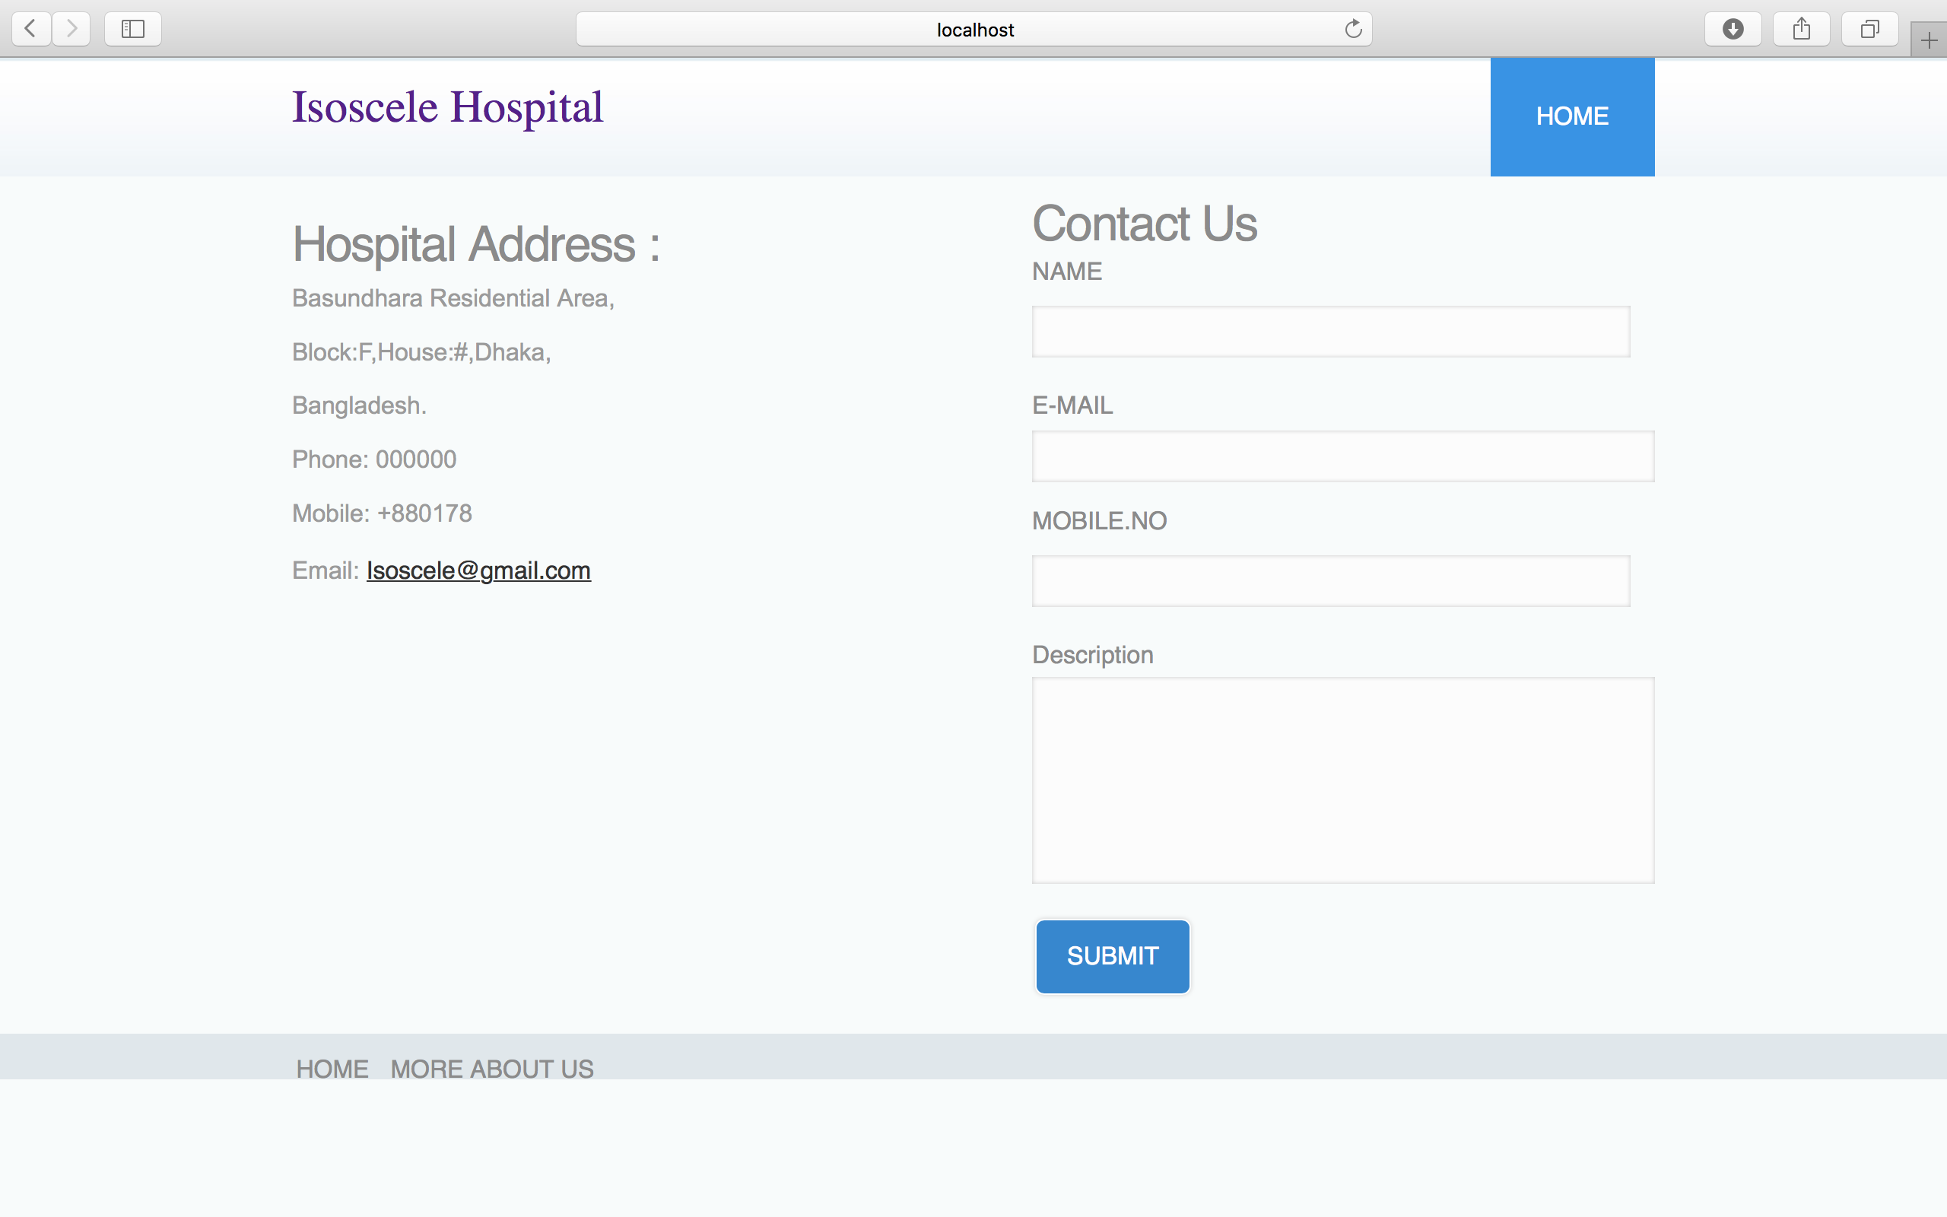

Slide 8
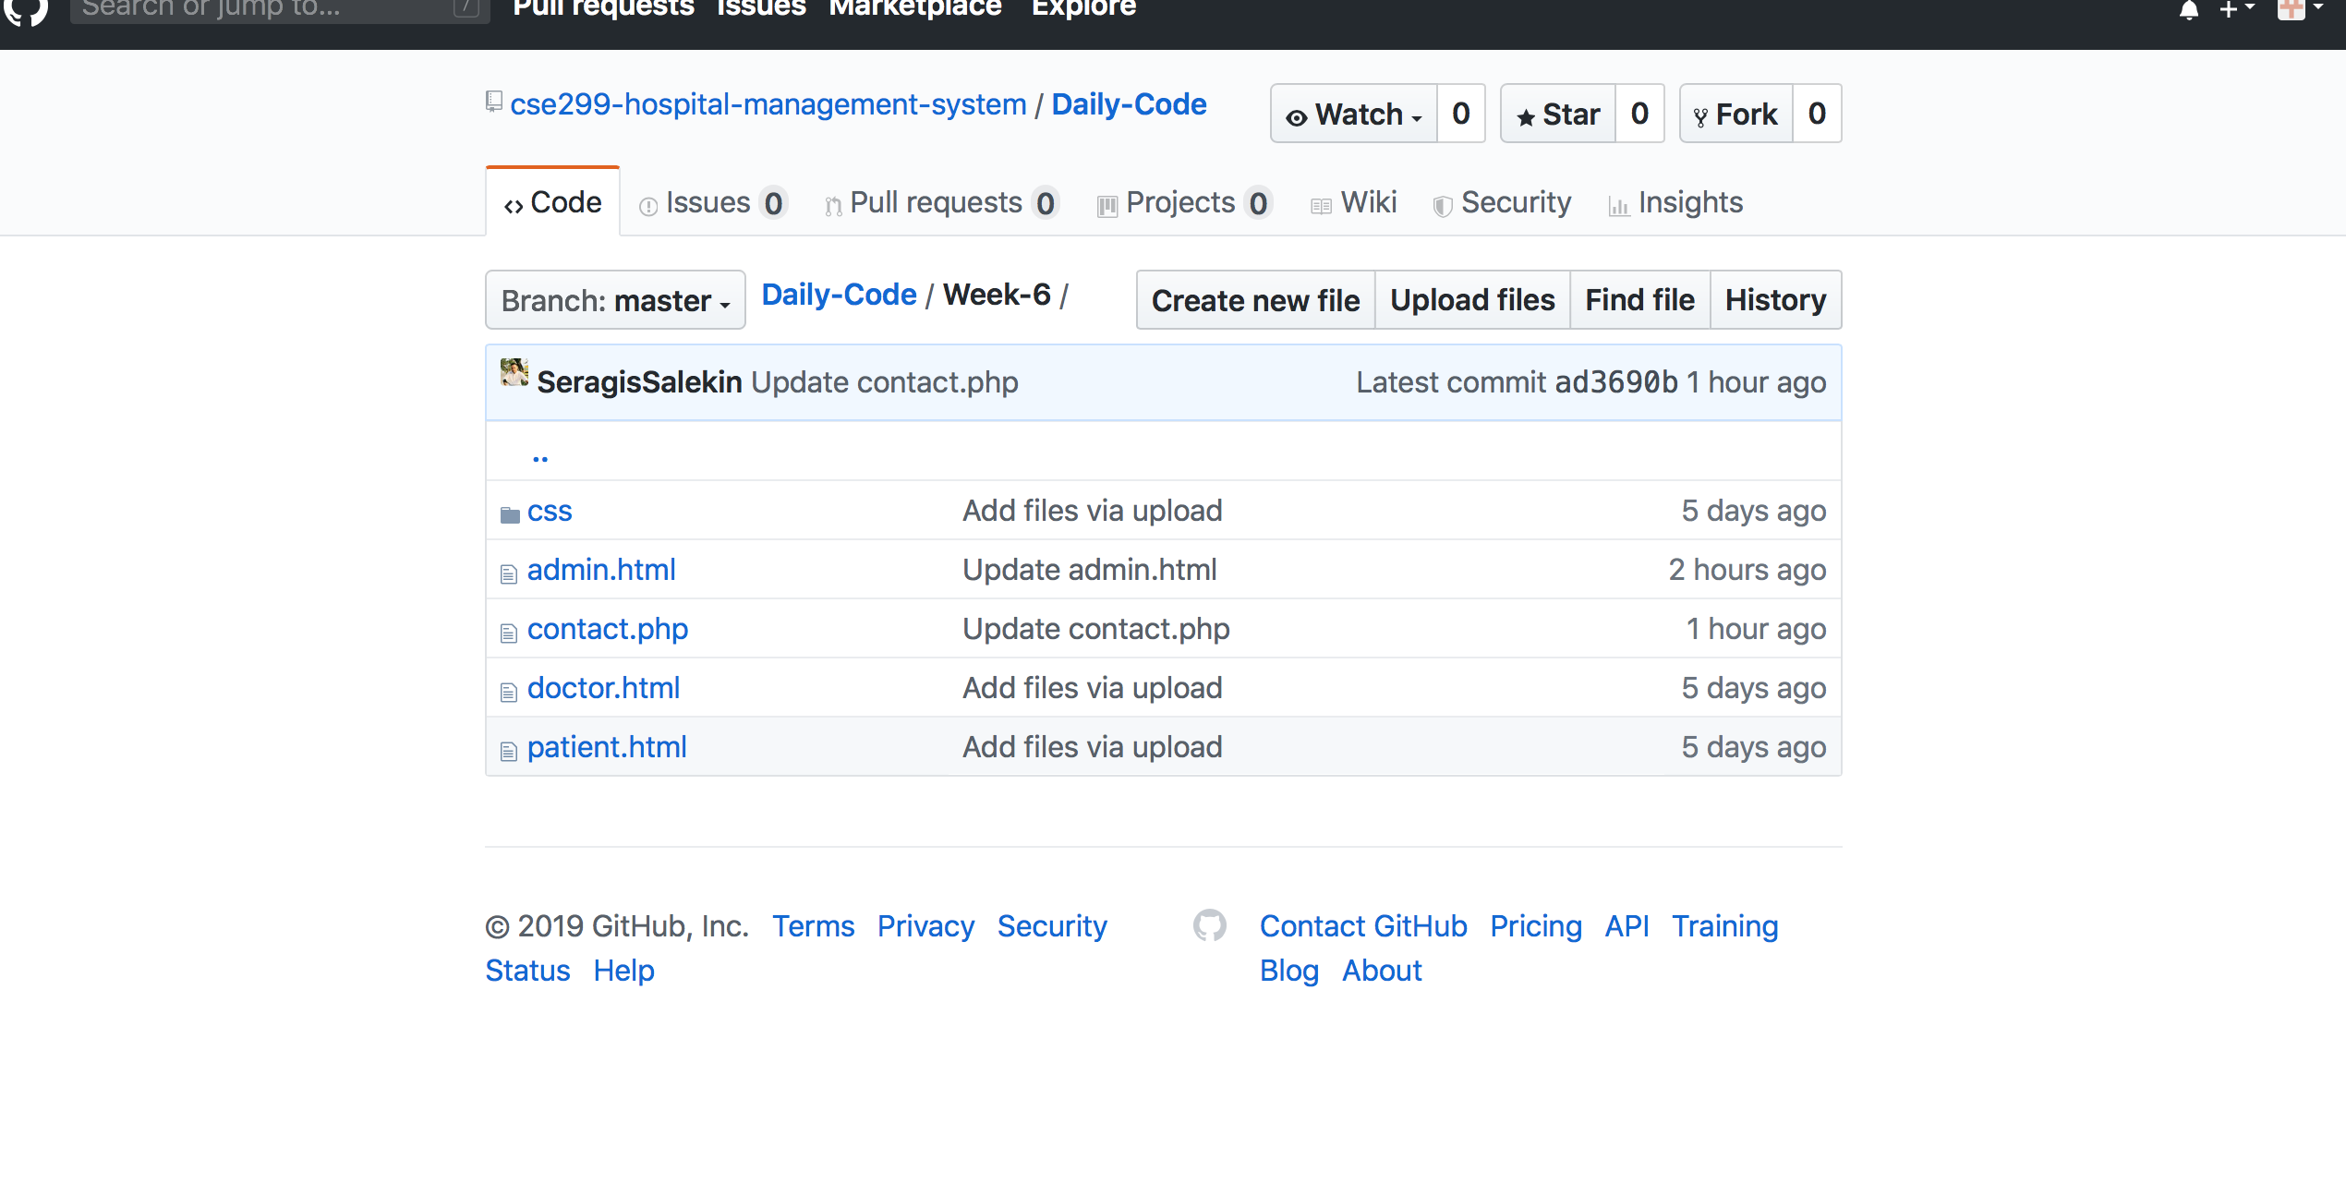

Slide 9
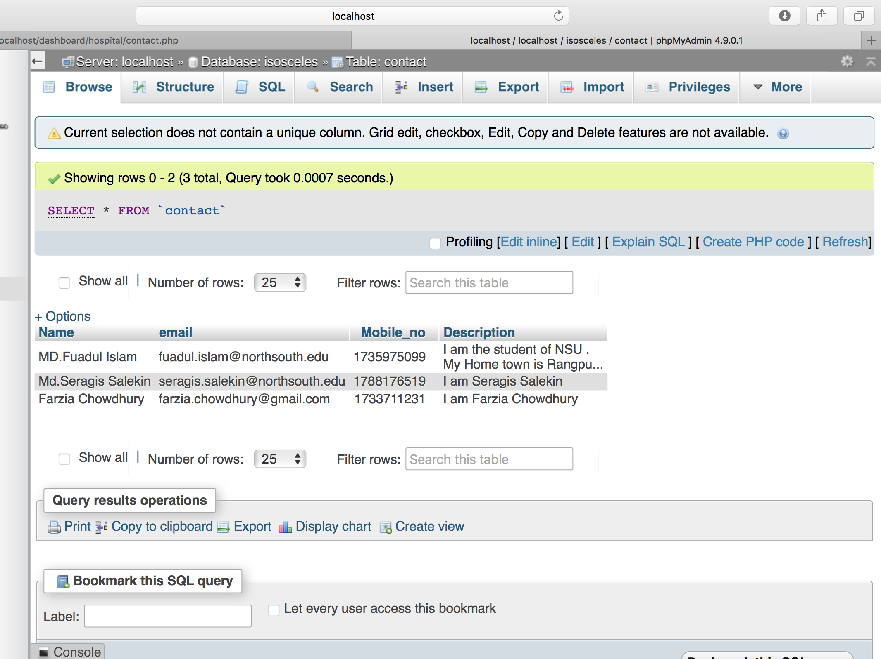

Slide 10
